Slide 1
Bills under consideration national and NY state
These Are proposed bills some of which will come up in the 2021 legislative session nationally
They are in review by a national coalition of grassroots environmental groups endeavoring to Cross and fact check to form a comprehensive earth bill
the earth bill will be offered to the 2022 congress for passage as a type of green new deal Bill.

Slide 2
time has run out!!!
Carbon clock
1.5 degrees Celsius will be reached in 6 years 9 months from March 2021 carbon budget entirely used up to be at net zero; uppermost safety limit for warming
2.0 degrees Celsius will be reached in 24 years 7 months from March 2021

Slide 3
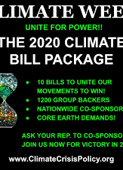
What is the mission?
To create a bill package that will provide the content or the skeleton for an overarching climate bill with these goals:
1.100% renewable energy by 2030
2. 100% zero emission vehicles by 2030
3. 100% zero emission steel and cement by 2030
4.100% regenerative farming by big Ag by 2030

Slide 4
Very quick outline of bills pending and being reviewed for the Earth Bill
FARM and Soil Regeneration Bills:

Slide 5
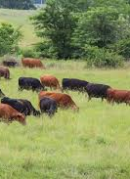
Agricultural resiliency act climate stewardship act food and agribusiness merger moratorium farm system reform act
Support and reward farmers for carbon sequestration, pasture based livestock systems, reduced food waste
Offsets for agricultural emissions, plants, trees, supports wetlands
Stops corporate consolidation
Targets CAFOS (Consolidated Animal Feeding Operations) with just transition components

Slide 6

Materials, refrigerants, plastics and Toxic pesticides
BREAK FREE FROM PLASTICS ACT:
fixing recycling problems, reduces waste, shifts burden of clean up to polluters, source, bans single use plastics, halts new plastic production, stops shipping waste to other countries.
Less than 10% of American plastic waste is recycled; plastic waste in the ocean is forcast to triple by 2040 without urgent action.
Ban toxins for Children: includes an educational component about most destructive toxins, labeling, protects farmers and children, bans toxins
The Ban Fracking Act: nationwide ban by Jan 2025, halts new permits/infrastructure, revokes permits for wells within 2500’ of homes, schools, just transition for Fossil Fuel workers.

Slide 7
What are the pesticide problems?
Acute chronic health problems for agricultural workers and their children
Soil water and air pollution
Affects nearby drinking water sources
Pesticide residues enter food chain
Bioaccumulation and biomagnification leading to human and wildlife tosicity (colony collapse)
Longevity in the environment
Destruction of the soil microbes, increases CO2 release into atmosphere and decreases carbon sink
What are the risks associated with synthetic pesticides?
Hormone disruption
Brain and nervous system toxicity
Cancer
Blood disorders
Reproduction Effects (PFOA’s may be driving toward sterility in males by mid century)
Birth Defects
Nerve disorders
Skin, eye and lung irritation

Slide 8
End Polluter welfare act:
Eliminates up to $150 B federal subsidies to Fossil Fuel industry over 10 years
Updates and recoups royalty rates for oil and gas production
Prohibits taxpayer funded fossil fuel research and development
Funds the black lung disability Fund
Federal Government subsidizes oil and gas, (and coal) giving them tax breaks at 7000(Million) to 1000Million over renewable tax breaks

Slide 9

Environmental justice for all act
Amends civil rights act to allow citizens and communities to seek legal remedies when policies or practices cause disparate impact
Grant $75M annually for R and D to reduce public health disparities
Require Federal agencies to consider cumulative health effects
Provide economic assistance to Fossil Fuel-dependent communities and just transition for workers

Slide 10
New 2021 Bills added to the 2020 bill package:
GHG Reduction Mandates
Clean Energy Investment/Clean Future Act: (50% reduction in GHG pollution from 2005 levels by 2030 and 100% clean economy with net zero GHG pollution by 2050 with a clean electric standard, clean transportation, efficiency, energy and buy clean energy and sustainability
flexibility to states to complete the transition to net zero, environmental justice protection, worker and community transition

Slide 11
Forest Protection and US products or Forest Crime free supply chain
Prohibits import of agricultural commodities illegally sourced
3rd party complaint mechanism
Tools to tackle deforestration related financial crimes
US government procurement preference for zero deforestation products

Slide 12
Green bank and
Bank Financing of Fossil Fuels
Prohibits certain financial companies from involvement in Fossil Fuel production including providing loans to and making investments in Fossil Fuel companies or projects, facilitating transactions that fund new FF production, securitizing assests that provide funds for new fossil fuel production and entering into deriviatives transactions related to new FF production

Slide 13
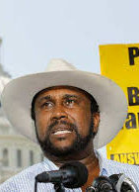
Racial justice in black farming
End discrimination within USDA with an independent civil rights oversight board
Protect remaining black farmers from Land Loss,
Restore the land base lost by black farmers,
Create a farm conservation corps
Empower Advocates
Assist all socially disadvantaged farmers and ranchers
Enact system reforms reforming and strengthening the Packers and Stockyaards Act to stop abusive bit multinational meatpacking companies

Slide 14
GHG Prohibition Utility Steam, Fracking and export bans
Prohibits emission of any GHG from new electric utility steam generating unit
Prohibit fracking on all onshore and offshore land within US as of Jan 2025
Prohibit exports of domestically produced crude oil and antural gas including LNG and natural gas liquids.

Slide 15
JUST transition
Revitalizing the Economy of Coal Communities by Leveraging Local activities and Investing More Act of 2019 or the Reclaim act
5.5M people live within 1 mile of an abandoned mine throughout Appalachia
Many of the states in Appalachia facing slashed state budgets and the opiod crisis and have limited access to resources and financial means. $1 B would be released from the Abandoned Mine Reclamation Fund to incentivize states and Indian tribes to carry on reclamation projects

Slide 16
Just Transition: American Jobs in Energy Manufacturing Act of 2021
For retool, expansion or new facilities that make or recycle energy related products and for use in communities where coal mines have closed
To build new or retrofit exiting manufacturing and industrial facilities to produce or recycle a wide range of energy products including:
Advance electric grid, energy storage, fuel cell equipment, equipment for production of low carbon low emission fuels, chemical and products, renewable energy and energy efficiency equipment from insulation to geothermal drills, products that capture remove use or store carbon dioxide, advance light to heavy duty vehicles and related upgrading facilities and provide assistance to create jobs.

Slide 17
Yikes!!! So Many Great bills, see our website, www.northcountryearthaction.org to download specific information/sponsors/house or senate numbers
There’s one on composting
Food waste in schools and in general
There’s a 21st century CCC to the tune of $9B/year
The Green New Deal is in proposed bill form for 2021, as well as GND for housing
Teaching climate change in schools
A food date labeling act

Slide 18
There are actually many bills being proposed in Congress in late winter 2021
Many have a focus on investments that will incentivize and reward in the following areas . The CCP team is studying all pending legislative proposal, cross checking where there is overlap:
Clean Electricity Generation, Grid Modernization, Transportation, Electrification, Transit and Smart Growth, Building Decarbonization, Affordable Housing, Manufacturing of Clean Technologies, Decarbonization of Industrial Processes, AgricultureConservation Pollution Cleanup
Community Investments, Economic Development, AdaptationTechnology Development, International Diplomacy

Slide 19
What legislation is pending in NYS?
Background: On July 18, 2019 the Climate Leadership and Community Protection Act (CLCPA) was signed into law. It is also known as New York State's "Climate Act". This Act established bold targets for decreasing greenhouse gas emissions, increasing renewable electricity production, and improving energy efficiency. Targets:
40% Reduction in GHG Emissions by 2030
85% Reduction in GHG Emissions by 2050 (from 1990 levels)
100% Zero-emission Electricity by 2040
70% Renewable Energy by 2030
9,000 MW of Offshore Wind by 2035
3,000 MW of Energy Storage by 2030
6,000 MW of Solar by 2025
22 Million Tons of Carbon Reduction through Energy Efficiency and Electrification

Slide 20
The Climate Act created the New York State Climate Action Council (Council), a 22-member committee that has been meeting and preparing a Scoping Plan to meet these bold targets. Co-Chairs of the Council are the heads of NYSERDA (NY State Energy and Research Development Authority) and DEC (Dept. of Environmental Conservation).
Current Action Needed Public support of the Climate and Community Investment Act (Senate Bill S4624) which now sits with the NY Senate Environmental Conservation Committee is vital. This is a funding bill to raise billions of dollars from corporate polluters, create thousands of green local jobs, protect workers currently in the fossil fuel industry, and help to fund NY State's transition from fossil fuels to clean renewable energy and reach the CLCPA targets.
To support Senate bill S4624 contact: State Senator Todd Kaminski, Chair of the Environmental Conservation Committee, at Phone: (518) 455-3401, and
State Senator Dan Stec- the ranking Republican on the Environmental Conservation Committee at phone: (518) 455-2811

Slide 21
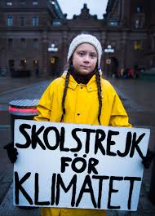
What can we do with this information?
1.Call and press Elise Stefanik to sponsor these bills or pick the ones you feel are most important to our area and ask her to sponsor them. She has the bill package.
2. Write letters to the editor about the bills you think are critical, mention the number and the senators sponsoring them by name and say why this is critical legislation
3. Lobby the CCA committee (see our website) to include these issues in the implementation and timeline for the CLCPA
4. Show up for your municipal meetings either by zoom or in person and make sure all these issues are being taken into account in town/city planning and emergency preparedness.
5. Direct Actions/demonstrations, lobbying days; get the word out, find our voices!!!!

Slide 22

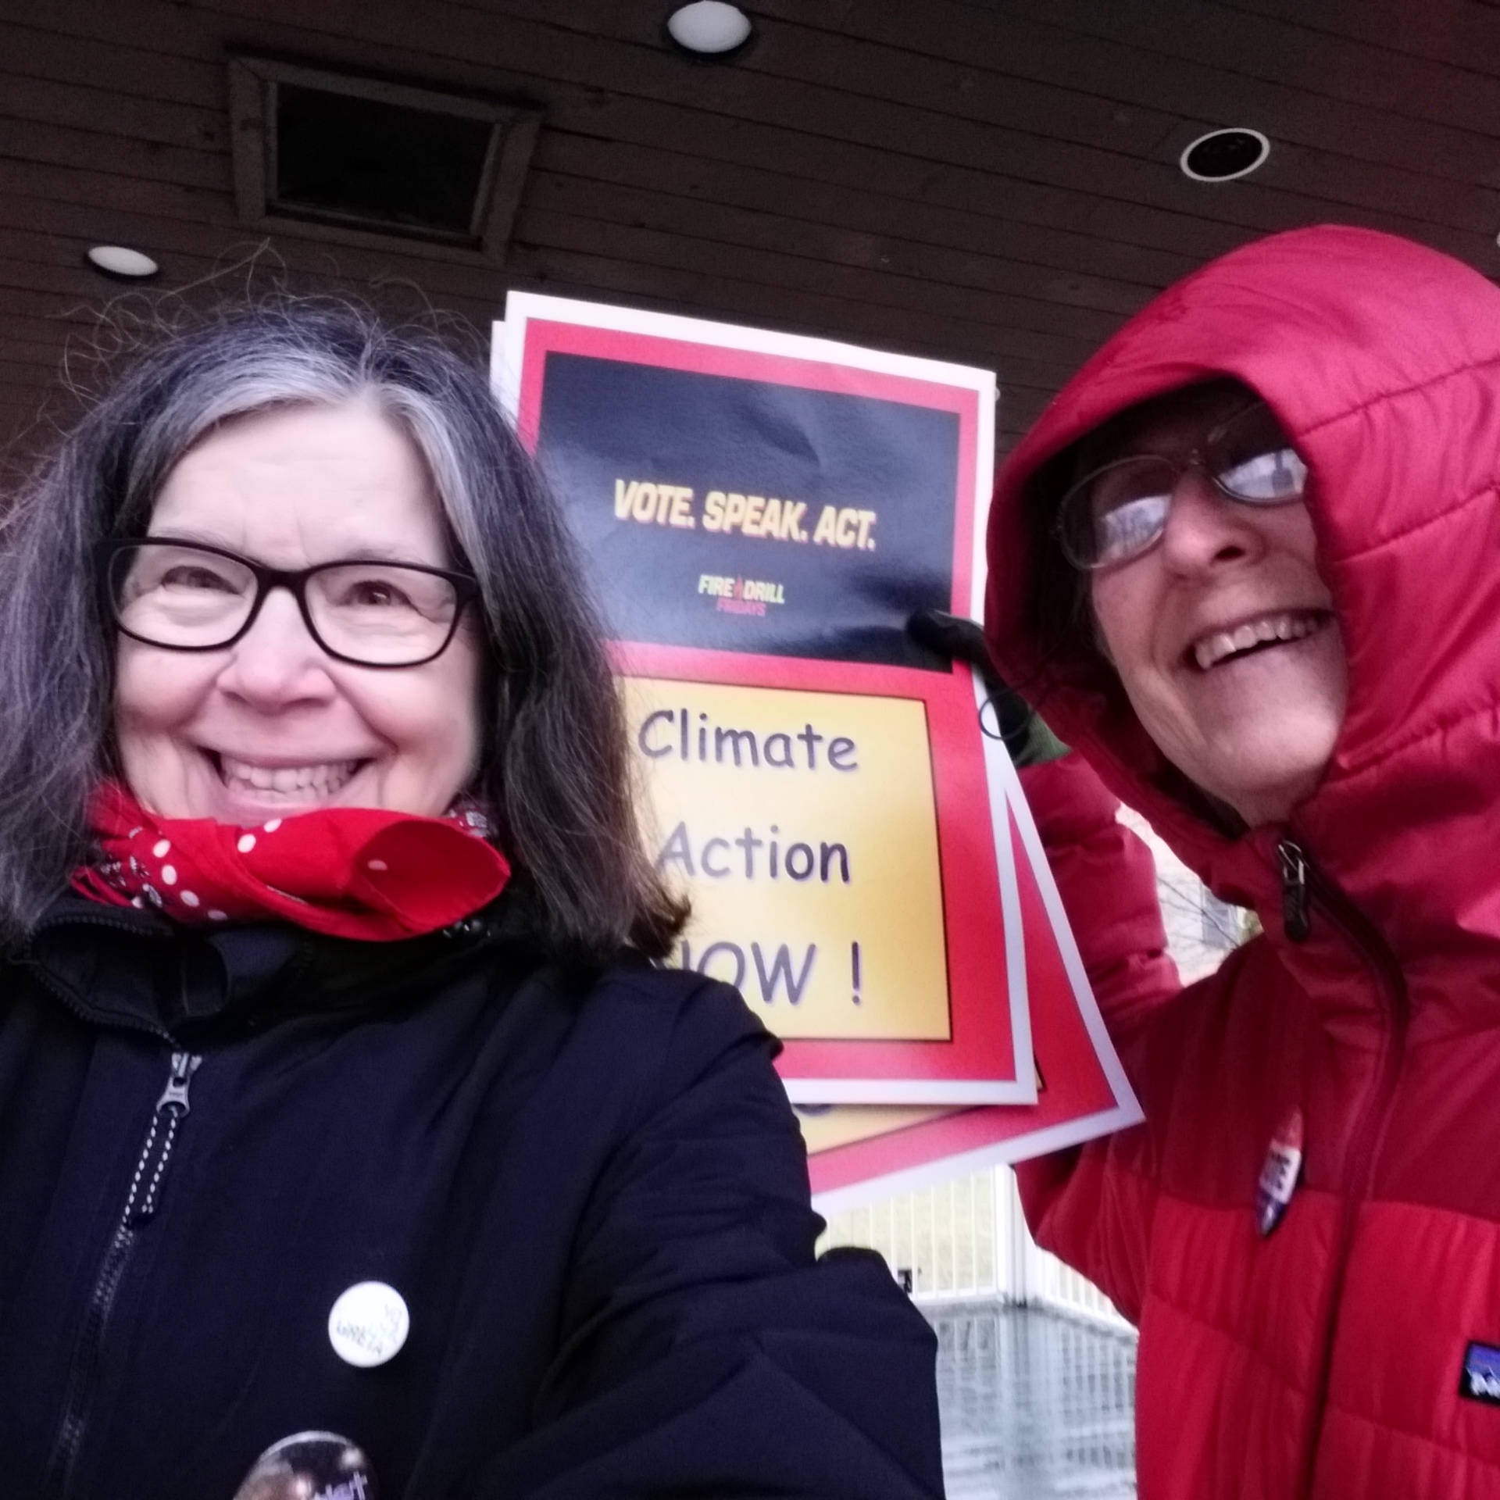
Find venues, actions, demonstrate, raise your voice, use the resources that exist
Contact earth Action Squad
At www.northcountryearthaction.org

Slide 23
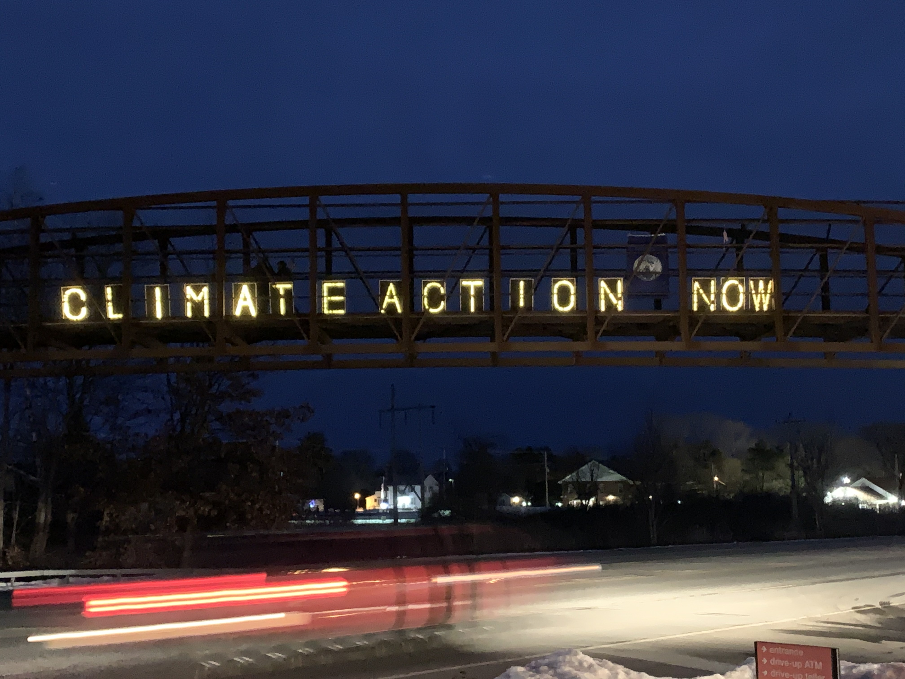
Friday night lights. Help us hold signs, take over for some of the regulars; help run the farmers market table, carry banners

Slide 24
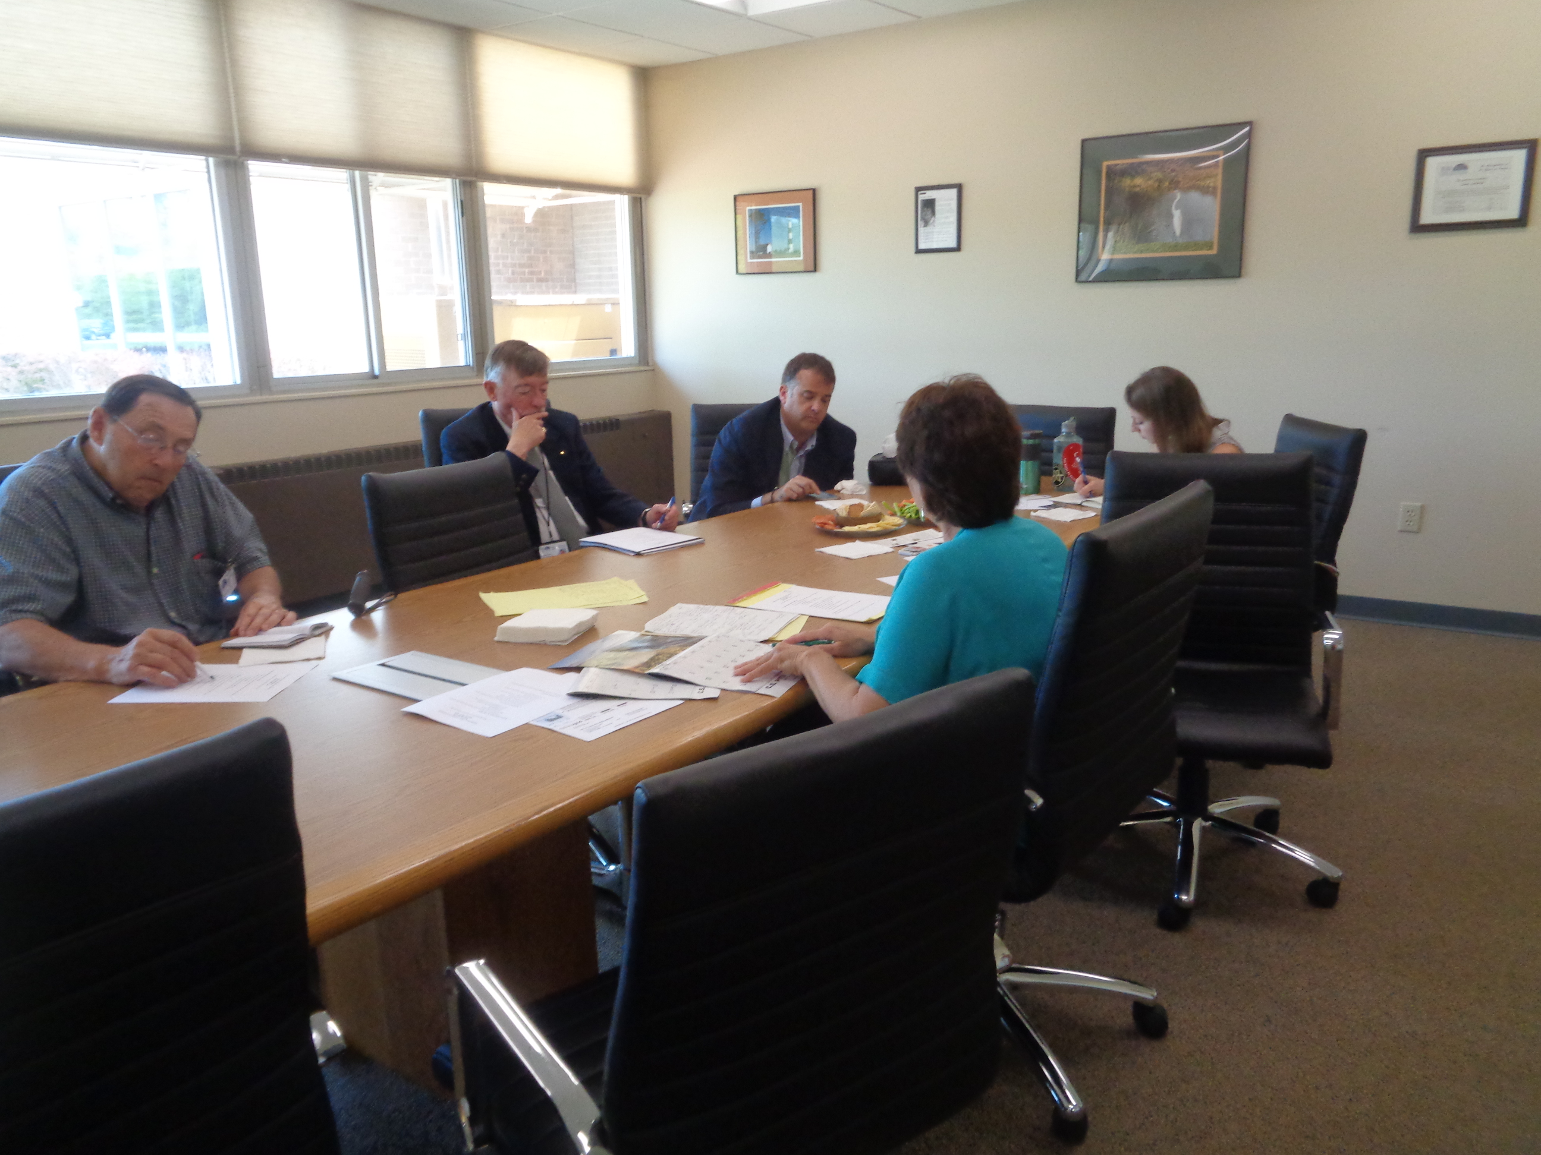
Lobby your town councils, join your town cec and csc committees and move things forward

Slide 25
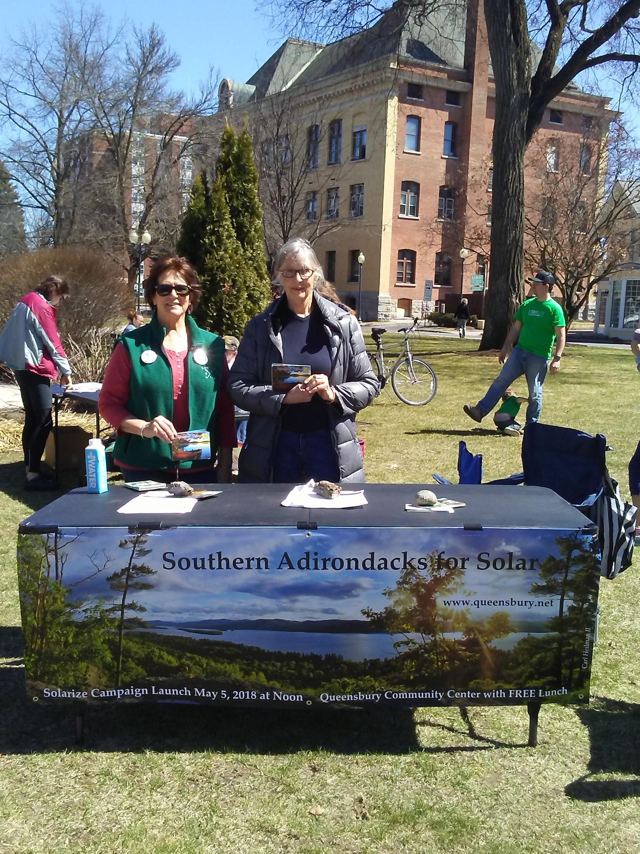
Volunteer for local events, earth day, re use day (June 2021)
Help this community become creative around climate response

